Slide 1

Bonjour Paris !
The Story of Using Data Science to Move Out

Slide 2


The Situation
Why Leaving Denmark ?
End 2019
Start 2020
Mid 2020
Decision to Move
Back to France
Lockdown
in Copenhagen
Coronavirus
Outbreak
Start in China
Global Pandemic
Declared

Slide 3
Data Science
How will it be used in the Situation ?
Data Science will be used for
Finding the best location in Paris to move in
Leverage data from the initial neighborhood in Copenhagen
Build a recommendation system with the data
Match Paris locations with user profile
Exploring the selected neighborhood surroundings
Assess venues in the neighborhood by looking around transportation stations
Cluster the stations regarding surrounding venues category
Retrieve information regarding the neighborhood characteristics and essence

Slide 4
Data Sourcing
Where are the Data coming from ?
Data Type | Sources
Copenhagen Address Coordinates | Google Maps
Copenhagen and Paris Venues | Foursquare
Paris Neighborhood Coordinates | Paris City Hall Database
Paris Transportation Stations Coordinates | RATP (Paris Transportation) Database

Slide 5
Methodology
How Machine Learnings will be used ?
Copenhagen Location
User Profile
Recommendations
Copenhagen Venues
Based on Venue Categories Score
Based on the Sum of Paris
Neighborhood Score
Paris Neighborhood Venues
Stations Clustering
Based on Surroundings Venues

Slide 6
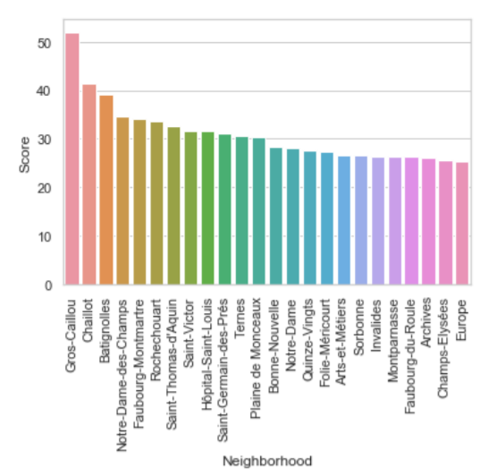
Results
What is the Best Neighborhood in Paris ?
Recommendation System says that
Gros Caillou is the Most Suited Neighborhood
More than 10 points than the second
No further investigation needed
Neighborhood Selected for the follow-up
User Profile revealed that
French Restaurants and Bakery were key venues
Already a bit of France in the initial neighborhood !

Slide 7

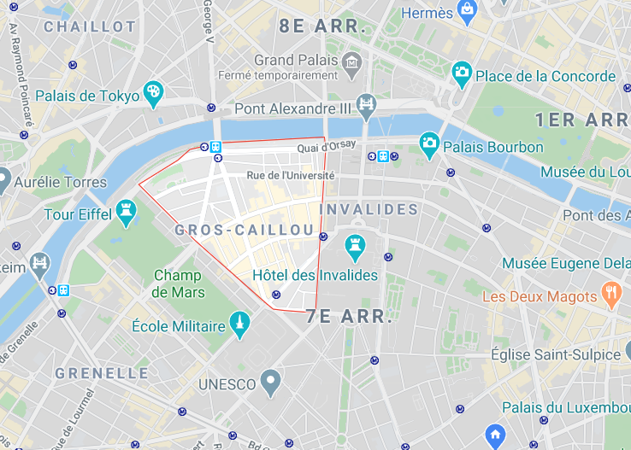


Results
What is the Best Neighborhood in Paris ?
Gros Caillou is in the 7th district of Paris
La Seine
Les Invalides
La Tour Eiffel

Slide 8
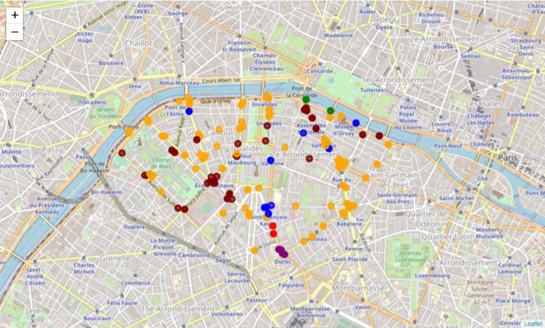
Results
What’s inside Gros Caillou neighborhood ?
Clustering identified
Five Clusters
One predominant and diverse
Three minors and very specific
Main Cluster is
Mainly composed of French Restaurants, Café, Plaza
Containing specificities of an historical neighborhood with tourist activities

Slide 9
Conclusions
Was the Approach Successful ?
The approach allowed to answer the questions raised by the situation
A Parisian neighborhood was found matching initial Copenhagen neighborhood
The selected neighborhood was explored to better understand its specificities
Approach was easy to implement and could be transposable for solving other issues such as
Find the best location to set up a shop
As a mayor develop the activity of a neighborhood
Create events that will suit with the neighborhood atmosphere

